Slide 1
UNIT –IV
CONTEXT- FREE LANGUAGES
C SE322-FLAT

Slide 2




Regular Languages

Slide 3
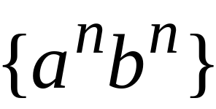
Context-Free Languages
Regular Languages

Slide 4
Context-Free Languages
Context-Free
Grammars
Pushdown
Automata
stack
automaton

Slide 5
Context-Free Grammars

Slide 6

Grammars
Grammars express languages
Example: the English language

Slide 7
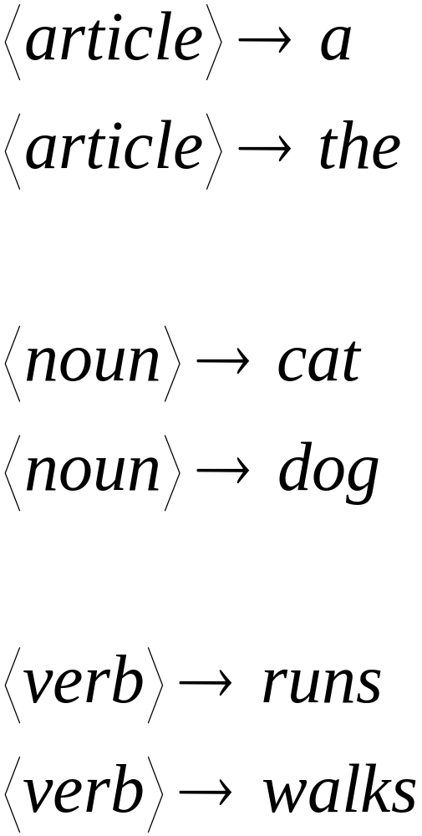

Slide 8
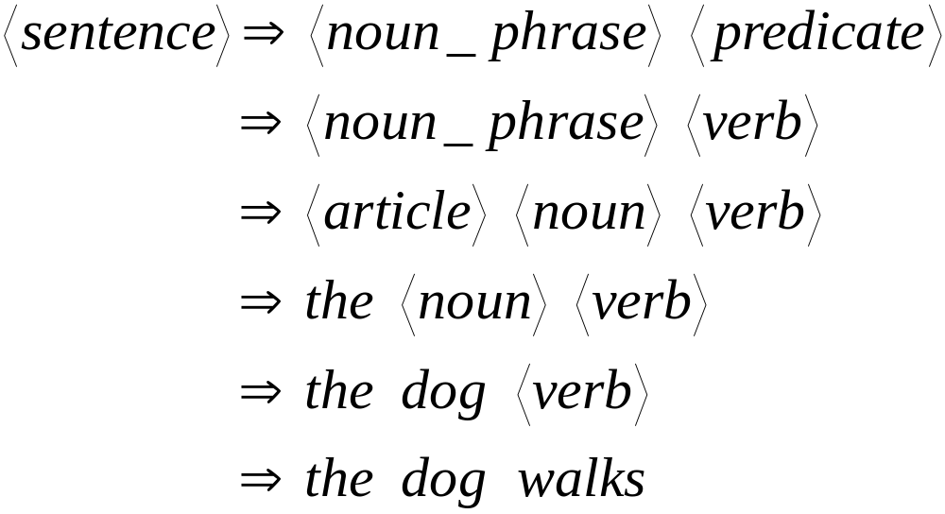
A derivation of “the dog walks”:

Slide 9
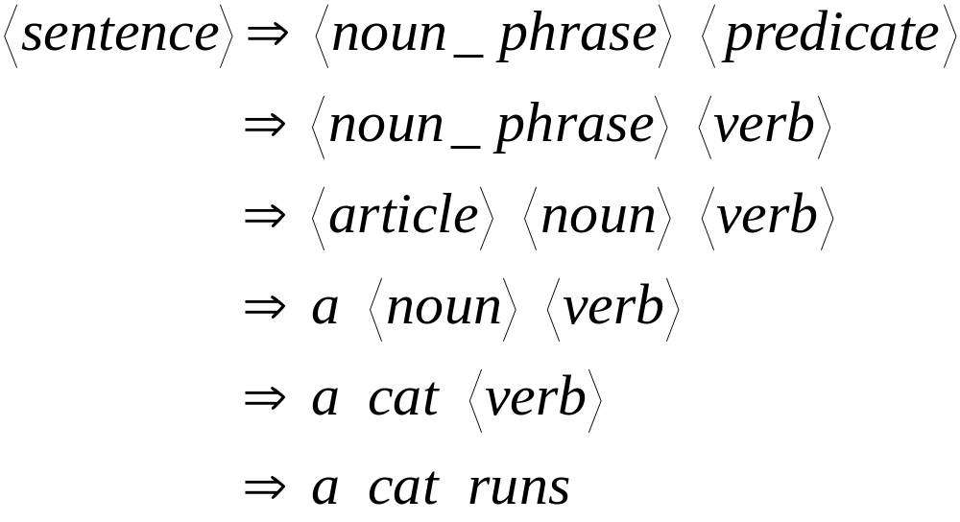
A derivation of “a cat runs”:

Slide 10
Language of the grammar:
L = { “a cat runs”,
“a cat walks”,
“the cat runs”,
“the cat walks”,
“a dog runs”,
“a dog walks”,
“the dog runs”,
“the dog walks” }

Slide 11
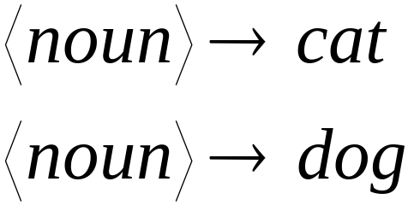
Notation
Production Rules
Variable
Terminal

Slide 12





Another Example
Grammar:
Derivation of sentence :

Slide 13



Grammar:
Derivation of sentence :

Slide 14

Other derivations:

Slide 15

Language of the grammar

Slide 16





More Notation
Grammar
Set of variables
Set of terminal symbols
Start variable
Set of Production rules

Slide 17




Example
Grammar :

Slide 18
More Notation
Sentential Form:
A sentence that contains
variables and terminals
Example:
Sentential Forms
sentence

Slide 19

We write:
Instead of:

Slide 20

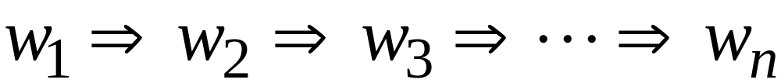
In general we write:
If:

Slide 21
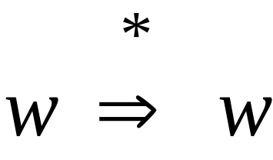
By default:

Slide 22
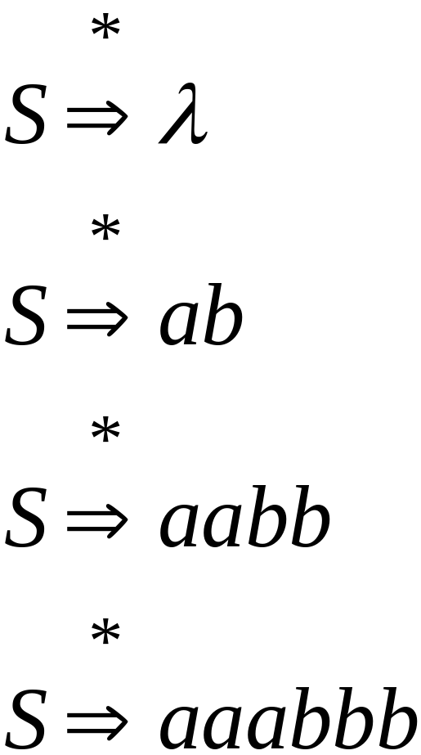
Example
Grammar
Derivations

Slide 23
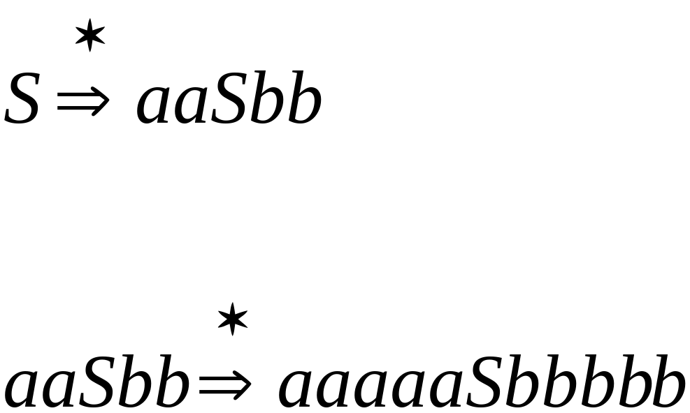
Example
Grammar
Derivations

Slide 24
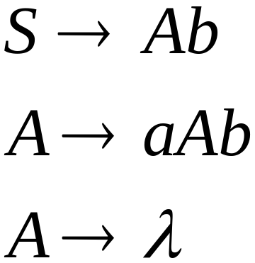
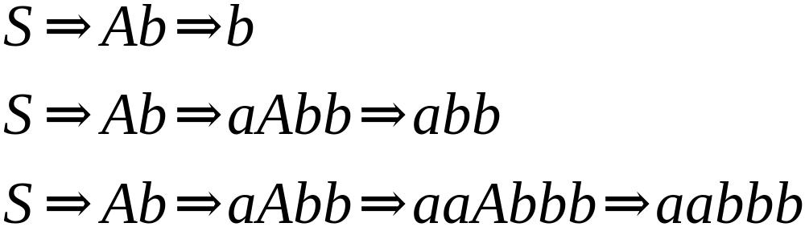
Another Grammar Example
Grammar :
Derivations:

Slide 25


Slide 26
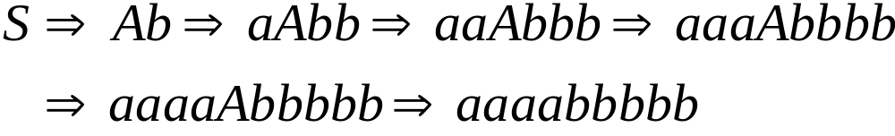
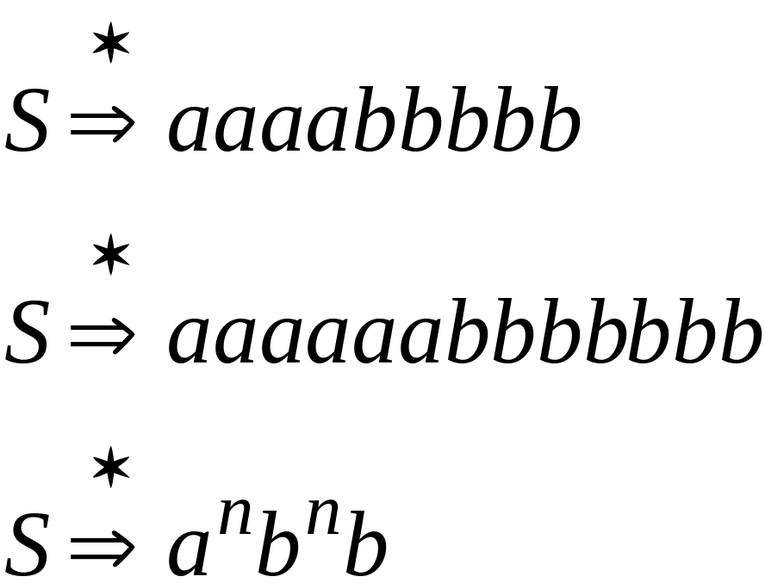
More Derivations

Slide 27

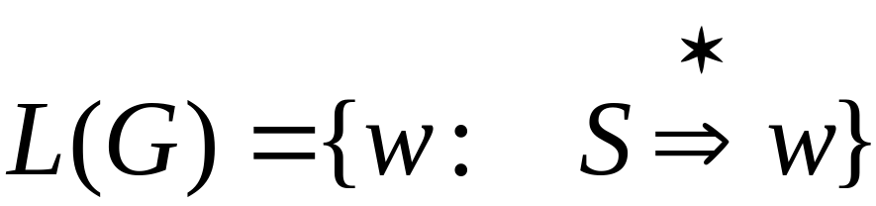
Language of a Grammar
For a grammar
with start variable :
String of terminals

Slide 28

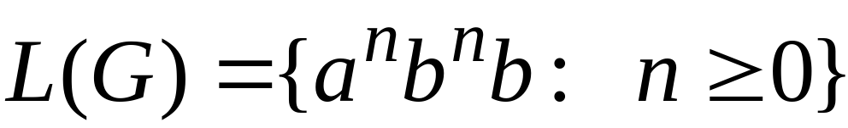
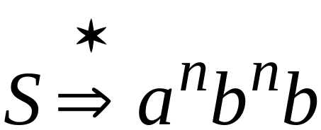
Example
For grammar :
Since:

Slide 29
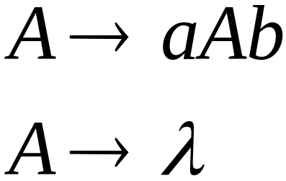
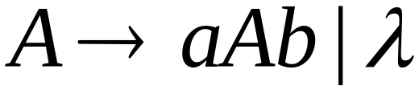
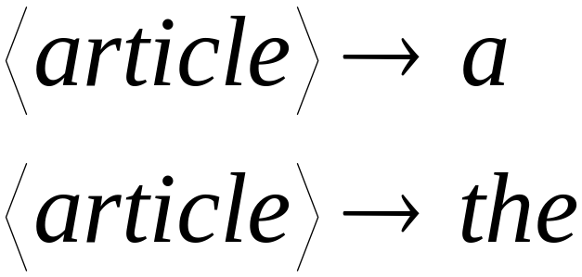
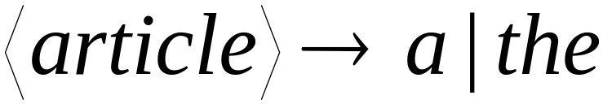
A Convenient Notation

Slide 30
Example
A context-free grammar :
A derivation:

Slide 31
A context-free grammar :
Another derivation:

Slide 32


Describes parentheses:
(((( ))))

Slide 33
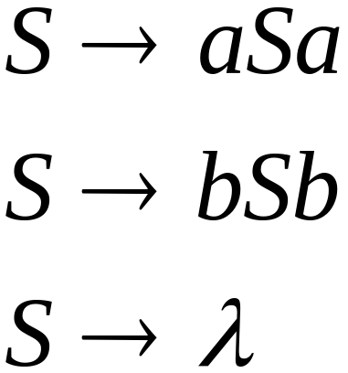
Example
A context-free grammar :
A derivation:

Slide 34
A context-free grammar :
Another derivation:

Slide 35


Slide 36
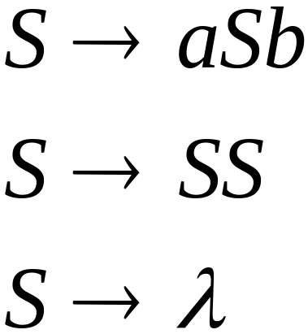
Example 2
A context-free grammar :
A derivation:

Slide 37
A context-free grammar :
A derivation:

Slide 38


Definition: Context-Free Grammars
Grammar
Variables
Terminal
symbols
Start
variable
Productions of the form:
Variable
String of variables
and terminals

Slide 39


Slide 40

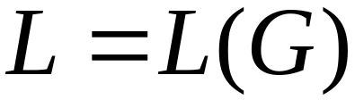
Definition: Context-Free Languages
A language is context-free
if and only if
there is a context-free grammar
with

Slide 41
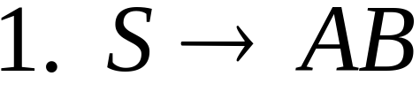
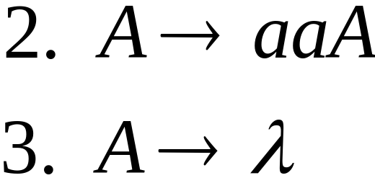
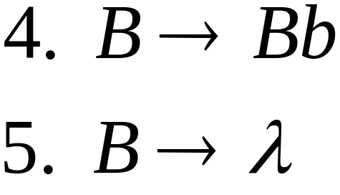


Derivation Order
Leftmost derivation:
Rightmost derivation:

Slide 43
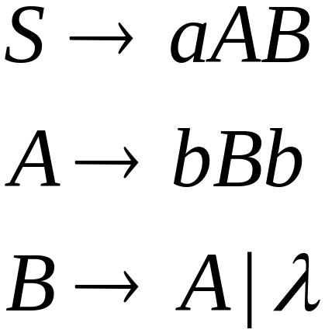
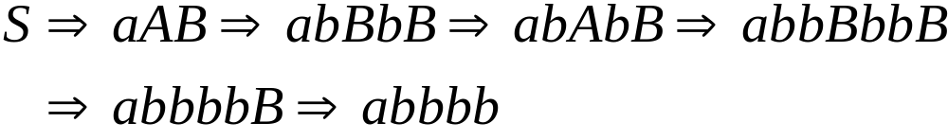
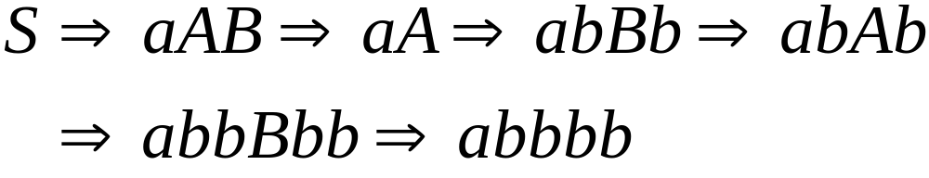
Leftmost derivation:
Rightmost derivation:

Slide 45
Derivation Trees

Slide 46

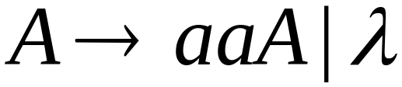
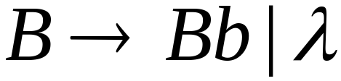





Slide 47



Slide 48


Slide 49


Slide 50
Derivation Tree

Slide 51
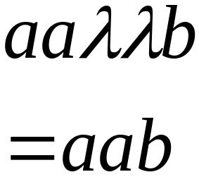
Derivation Tree
yield

Slide 52
Partial Derivation Trees
Partial derivation tree

Slide 53
Partial derivation tree

Slide 54

sentential
form
Partial derivation tree
yield

Slide 55
Sometimes, derivation order doesn’t matter
Leftmost:
Rightmost:
Same derivation tree

Slide 56
Practice questions
Find a LM derivation for aaabbabbba with the productions.
P : S ->aB / bA, A -> a /S / bAA, B ->b / bS / aBB
2. Let G be a grammar
S->OB/1A, A->O/OS/1AA, B->1/1S/OBB.
For the string 00110101 find its leftmost derivation and derivation tree.

Slide 57
3. CFGs are more powerful than
(a)DFA(b)Mealy Machine(c)NFA(d)All of the mentioned
4. __________ is the graphical representation of a grammar.
(a)Binary tree(b)Red black tree(c)Parse tree(d)None of the mentioned

Slide 58
Practice Questions
5. What is derivation in grammar?
(A)Derivation is a sequence of production rules and derive the input string or terminal from
those
(B) production rules.
(C) Deriving set of non terminals derived from production rules.
(D)All of above.
6. Which of the following statement is false?
a) In derivation tree, the label of each leaf node is terminal
b) In derivation tree, the label of all nodes except leaf nodes is a variable
c) In derivation tree, if the root of a sub tree is X then it is called –tree
d) None of these

Slide 59
Construction of CFG from given language
Ex1: Construct a CFG for a language L = {wwR | where w € (a, b)*}.
Solution : for the given language the strings will be like
{aa, bb, abba, baab, abbbba, ....}
So the production rules for the grammar can be :
S-> aSa | bS b | Ɛ
Now with the derivations rule , generate the various types of the strings from the given production rules.
S-> a S a
=> a b S b a
=> abba

Slide 60
Ex#2: Construct a CFG for the language L = a^{n}b^{2n} where n>=1.
Solution :From the given language the strings can be generated as :
L={ abb,aabbbb,aaabbbbbb……}
So according to the strings , production rules of the Grammar will be as:
S-> aSbb | abb
(we cant’s make /produce Ꜫ coz the minimum strings is abb rather Ꜫ )
We can derive the strings from given production rules an d check the given language .

Slide 62
Ex#3: Construct a CFG for the regular expression (0+1)*
Solution : As per the given regular expression for the language , the strings can be generated as:
L={ 0,1,00,11,101,010,00110…….}
So production rules for the grammar will be as:
S-> 0S| 1S | Ɛ

Slide 63
Ex#4: Construct a CFG that generates all the strings over {0,1} having substring 0011.
Solution : According to the given language the strings can be generated as
L={ 0011,100110,0001101…….}
So the minimum strings will be generated 0011.
The production rules will be as: S->A0011A
A->0A | 1A | Ꜫ
Now derive the strings and check the production rules for CFG

Slide 64
Construction of Language from given CFG
EX#1: For the grammar given below, find out the context free language. The grammar G = ({S}, {a, b}, S, P) with the productions are;
S → aSa, (Rule: 1)
S → bSb (Rule: 2)
S → ε (Rule: 3)

Slide 65
Solution
First compute some strings generated by the production rules of the grammar G in the above;
(i) S ⇒ aSa, (Rule: 1)
⇒ aεa, (Rule: 3)
i.e. ⇒ aa
(ii) S ⇒ bSb, (Rule: 2)
⇒ bεb, (Rule: 3)
i.e. ⇒ bb
(iii) S ⇒ aSa, (Rule: 1)
⇒ abSba, (Rule: 2)
⇒ abεba (Rule: 3)
i.e. ⇒ abba
(iv) S ⇒ bSb, (Rule: 2)
⇒ baSab, (Rule: 1)
⇒ ba ε ab (Rule: 3)
i.e. ⇒ baab
(v) S ⇒ aSa, (Rule: 1)
⇒ aaSaa, (Rule: 1)
⇒ aabSbaa, (Rule: 2)
⇒ aabbSbbaa, (Rule: 2)
⇒ aabb ε bbaa (Rule: 3)
i.e. ⇒ aabbbbaa

Slide 66
Contd…
Hence; Language generated by the above grammar L(G) = {aa, bb, abba, baab, aabbaa, aabbbbaa,.. .. .. .. }
By analyzing the above generated string form the grammar G, there has a similar pattern in all computed strings, i.e.
The length of the string is even always i.e. length of the string L(w) ≥ 2 × i | i = 1, 2, 3, 4.. .
From the half length of the string, string is the reverser of each other side i.e. string is generated by the language is palindrome.
Thus we can write the language of the grammar
L(G) = {ww^{R} : w ∈ {a, b}*};

Slide 67
Ex#2:
For the grammar given below, find out the context free language. The grammar G = ({S}, {a, b}, S, P) with the productions are;
S → abB, (Rule: 1)
A → aaBb (Rule: 2)
A → ε (Rule: 3)
B → bbAa (Rule: 4)

Slide 68
Solution
First compute some strings generated by the production rules of the grammar G in the above;
(i) S ⇒ abB, (Rule: 1)
⇒ ab bbAa (Rule: 4)
⇒ ab bb ε a (Rule: 3)
i.e. ⇒ ab bba
(ii) S ⇒ abB, (Rule: 1)
⇒ ab bbAa (Rule: 4)
⇒ ab bb aaBb a (Rule: 2)
⇒ ab bb aa bbAa ba (Rule: 4)
⇒ ab bb aa bb ε a ba (Rule: 3)
i.e ⇒ ab bb aa bba ba
(iii) S ⇒ abB, (Rule: 1)
⇒ ab bbAa (Rule: 4)
⇒ ab bb aaBb a (Rule: 2)
⇒ ab bb aa bbAa ba (Rule: 4)
⇒ ab bb aa bb aaBb a ba (Rule: 2)
⇒ ab bb aa bb aa bbAa b a ba (Rule: 4)
⇒ ab bb aa bb aa bb ε a b a ba (Rule: 3)
i.e ⇒ ab bb aa bb aa bba ba ba

Slide 69
..Contd..
Hence; Language generated by the above grammar L(G) = { ab bba (minimum string)
ab bb aa bba ba
ab bb aa bb aa bba ba ba
ab bb aa bb aa bb aa bba ba ba ba
⋮
⋮
}
By analyzing the above generated string form the grammar G, there has a similar pattern in all computed strings, i.e.
The minimum length of the string consist ab bba always.
After obtained the minimum string there have some repetition of strings comes i.e. the loop of string (bb aa and ba) comes finite times. (Note: Highlighted by underlined strings)
Thus we can write the language of the grammar
L(G) = {ab (bb aa)^{n} bba (ba)^{n} : n ≥ 0}

Slide 70
Practice Questions
Q1: Construct the CFG that generate any sequence of 0’s and 1’s .
Q2: Construct the CFG that accepts all strings from the language L = {w | na(w) = nb(w)}
Q3: Construct the CFG that generate language L = {w2wR | where w € (0, 1)*}.
Q4: Construct the CFG that generate the balanced paranthesis.

Slide 71
Solution for the Practice questions in previous slide
S->0S | 1S | 0 | 1 | Ɛ
S-> SS | aSb | bSa | Ɛ
S->0S0 | 1S1 | 2
S-> (S) | SS | Ɛ

Slide 72
Practice Questions :
Q#1: For the grammar given below, find out the context free language. The grammar G = ({S}, {a, b, c}, S, P) with the productions are;
S → aSa, (Rule: 1)
S → bSb (Rule: 2)
S → c (Rule: 3)
a) L(G)={ anbn| n>=1}
b) L(G) = {wcwr | w ={a,b)*}
c) L(G) = { wwr | w ={a,b)*}
d) None of above

Slide 73
Ambiguity

Slide 74





leftmost derivation

Slide 76

leftmost derivation

Slide 77
Two derivation trees

Slide 78
The grammar
is ambiguous:
string
has two derivation trees

Slide 79
The grammar
is ambiguous:
string
has two leftmost derivations

Slide 80

Definition:
A context-free grammar is ambiguous
if some string has:
two or more derivation trees

Slide 81
In other words:
A context-free grammar is ambiguous
if some string has:
two or more leftmost derivations
(or rightmost)

Slide 82

Why do we care about ambiguity?
take

Slide 83



Slide 84






Slide 85
Correct result:

Slide 86
Ambiguity is bad for programming languages
We want to remove ambiguity

Slide 87
Practice Questions
G denotes the context-free grammar defined by the following rules. ` S->ASB/ab/SS A->aA/A ,B->bB/A
Show that G is ambiguous.

Slide 88
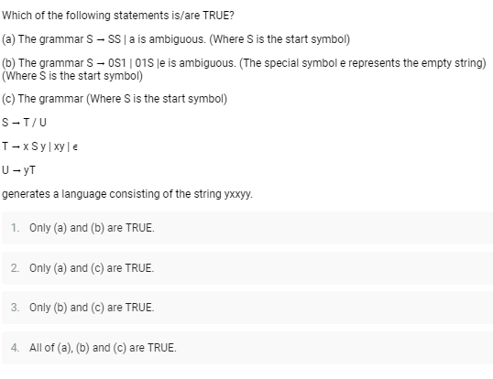
Q. No. 2

Slide 89
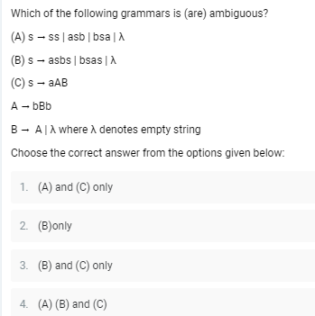
Q. No 3

Slide 90
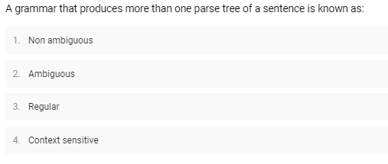
Q. N o 4:

Slide 91
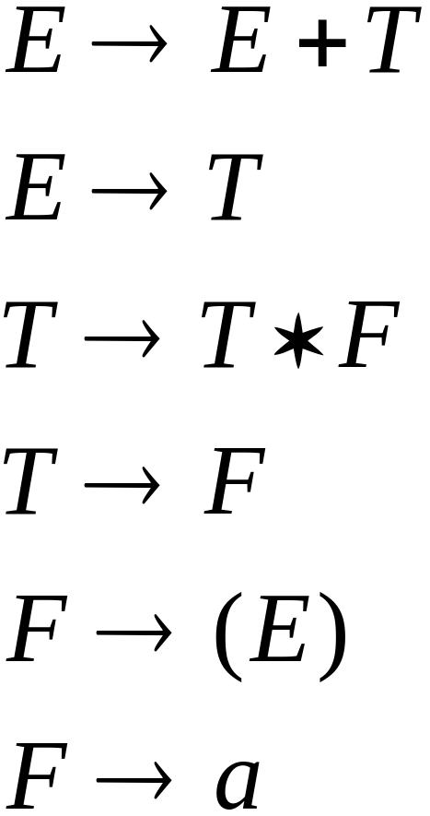
We fix the ambiguous grammar:
New non-ambiguous grammar:

Slide 92




Slide 93
Unique derivation tree

Slide 94
The grammar :
is non-ambiguous:
Every string has
a unique derivation tree

